Slide 1


Final Project
A Comprehensive Data Analysis and Visualization
Team Members:
Falguni Nayi (200559976)
Niki Patel (200545936)
Ramanan Thayalan (200565744)

Slide 2


Dataset Name: Customer Segmentation Data
Source:
Kaggle: https://www.kaggle.com/code/nataliaole/cc-general-clustering
GitHub: https://github.com/rubaramanan/socialdatamine_final/blob/main/src/Final.ipynb
Key Attributes:
Customer ID: Unique identifier for each customer.
Balance: Credit card balance for each customer.
Purchase Category: Spending categories (e.g., groceries, travel).
Credit Utilization: Ratio of balance to credit limit.

Slide 3

Data Cleaning & EDA
Steps Taken:
Handled missing values in CREDIT_LIMIT and MINIMUM_PAYMENTS (mean/median imputation).
Removed highly correlated features (ONEOFF_PURCHASES with PURCHASES).
Dropped CUST_ID as it doesn't contribute to analysis.
Standardized numerical features for clustering and modeling.

Slide 4
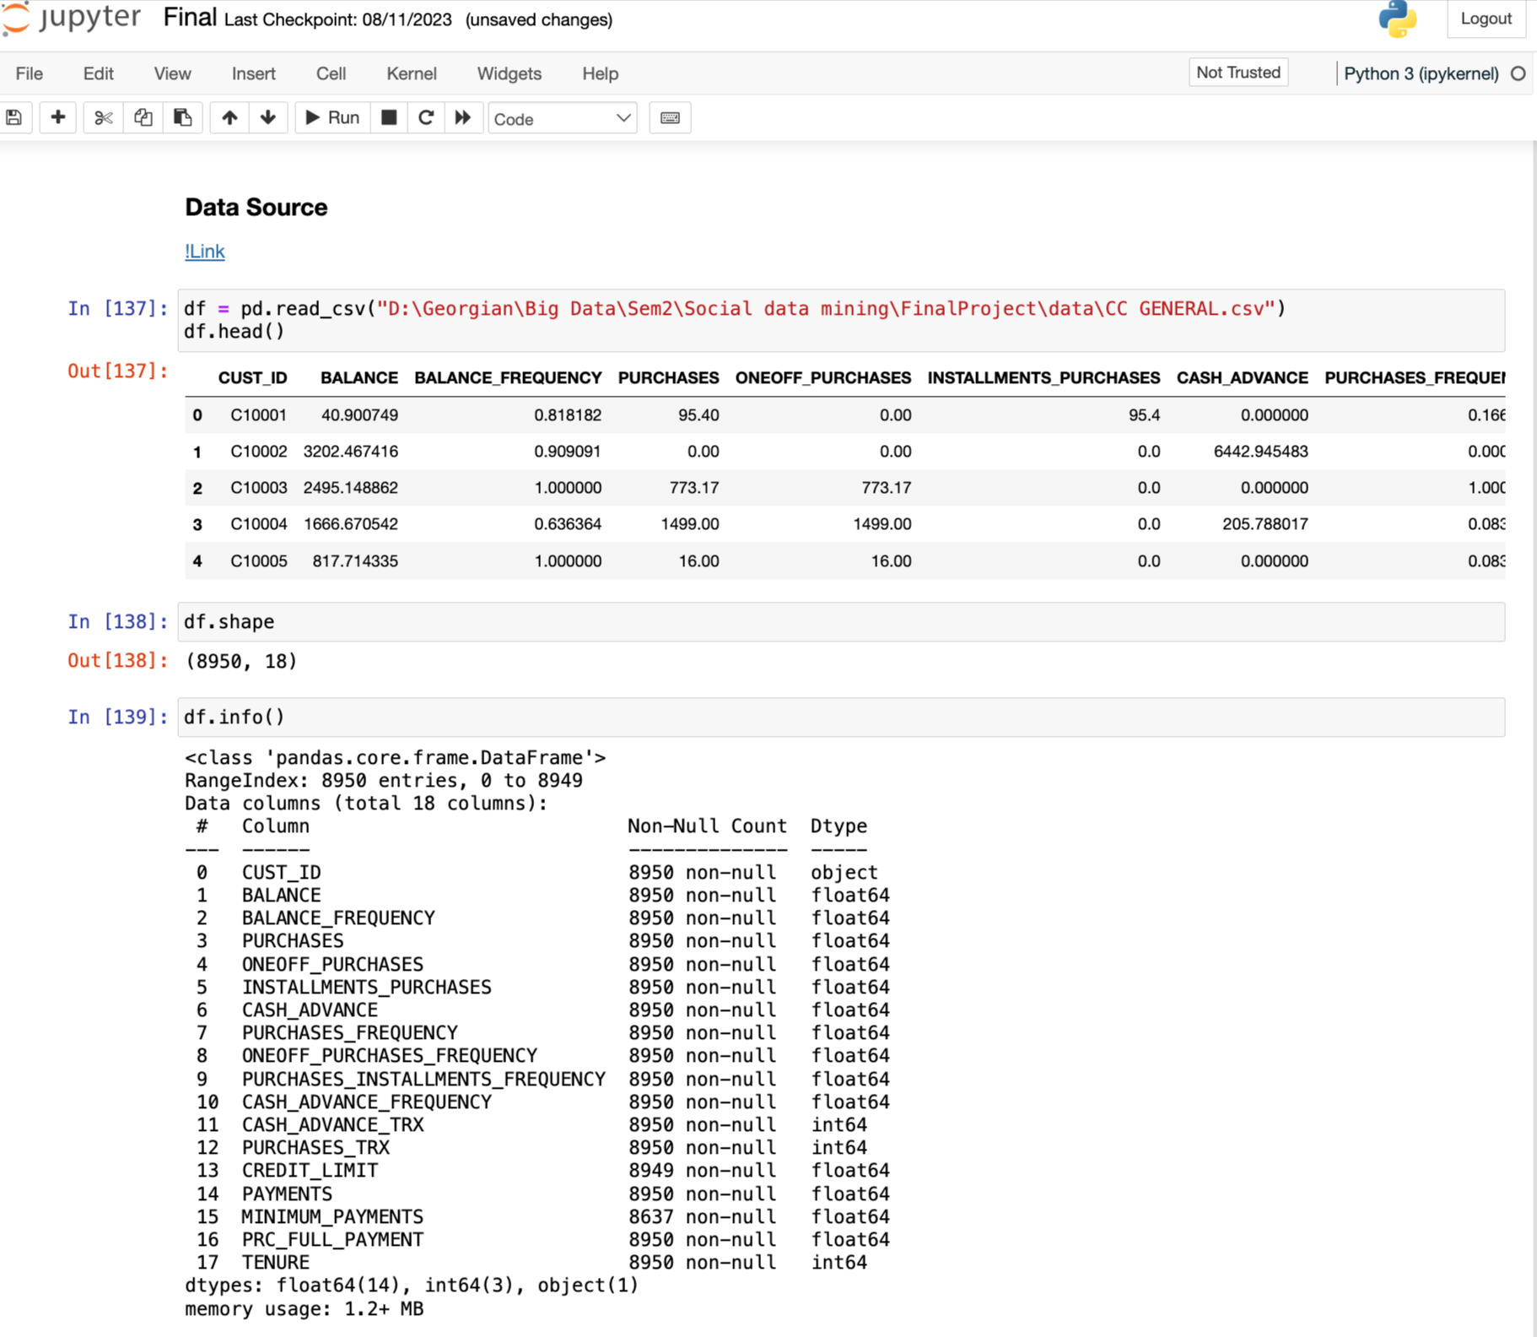
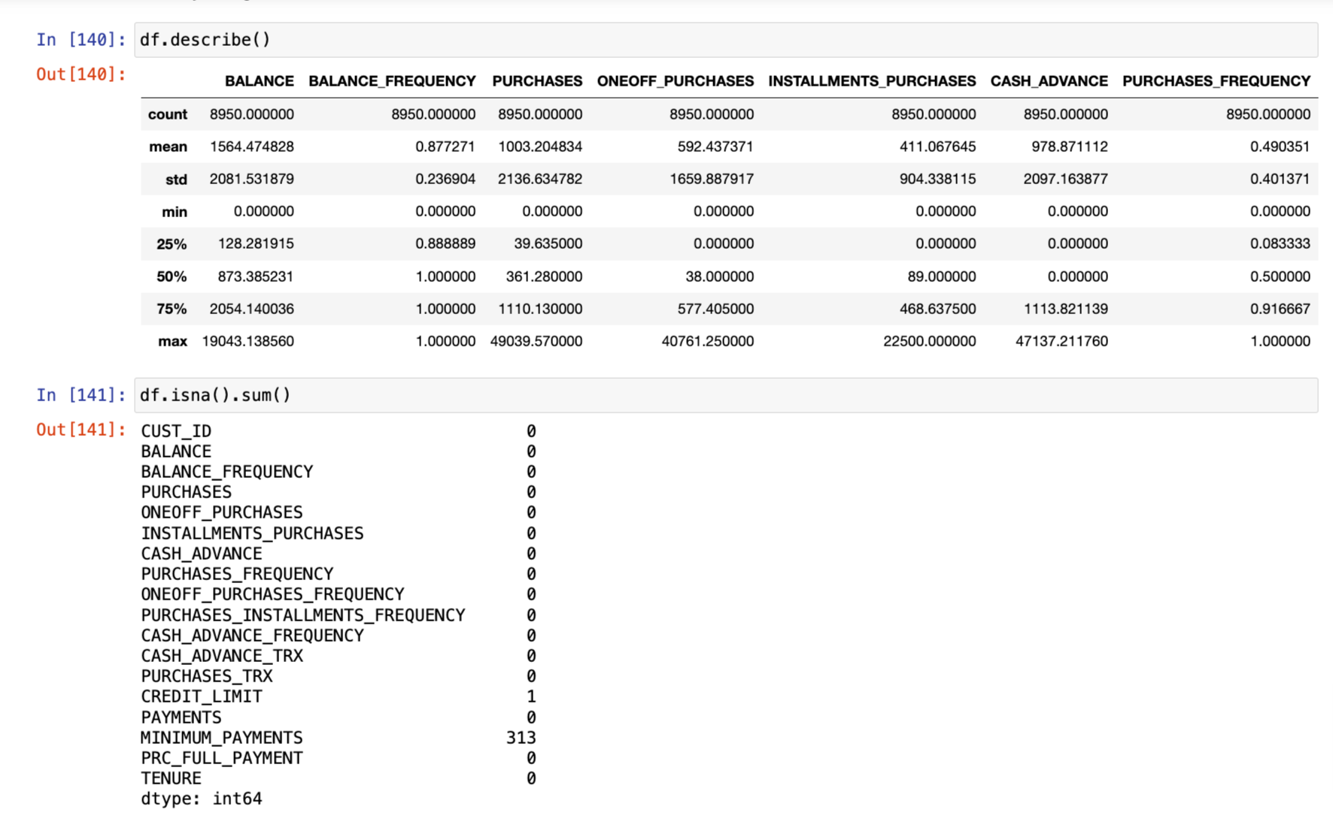
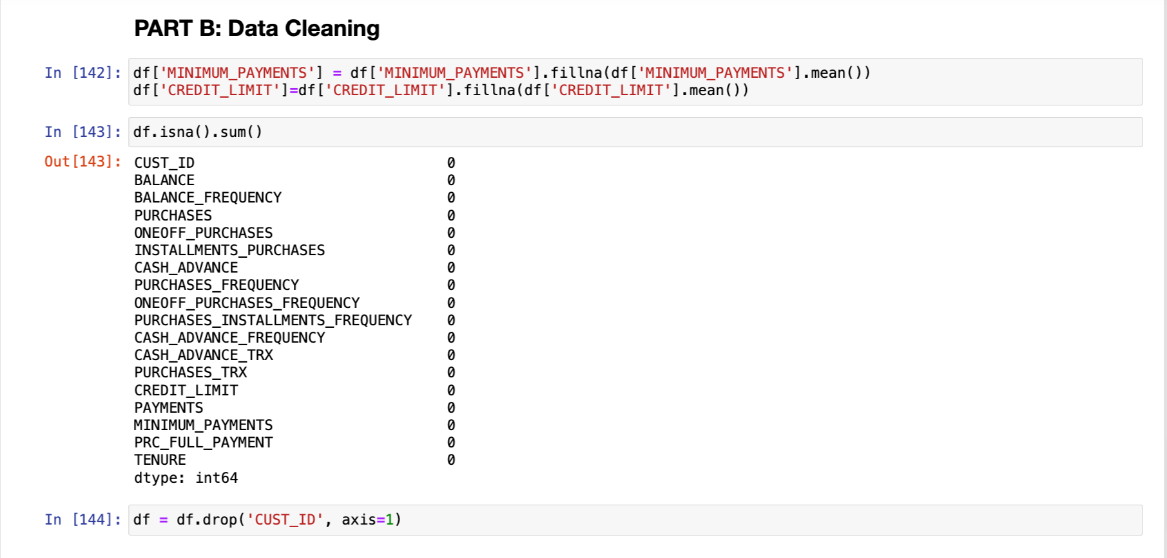

Slide 5
Steps:
Applied PCA for dimensionality reduction (95% variance retained).
Determined optimal clusters using the Elbow Method (k=3).
Purpose:
Segment customers into groups based on spending behavior.
Results:
Three clusters identified:
High Spenders
Moderate Spenders
Low Spenders
Visualization:
PCA Scatterplot with Clusters
Technique: K-means Clustering
Completed by - Ramanan Thayalan

Slide 6
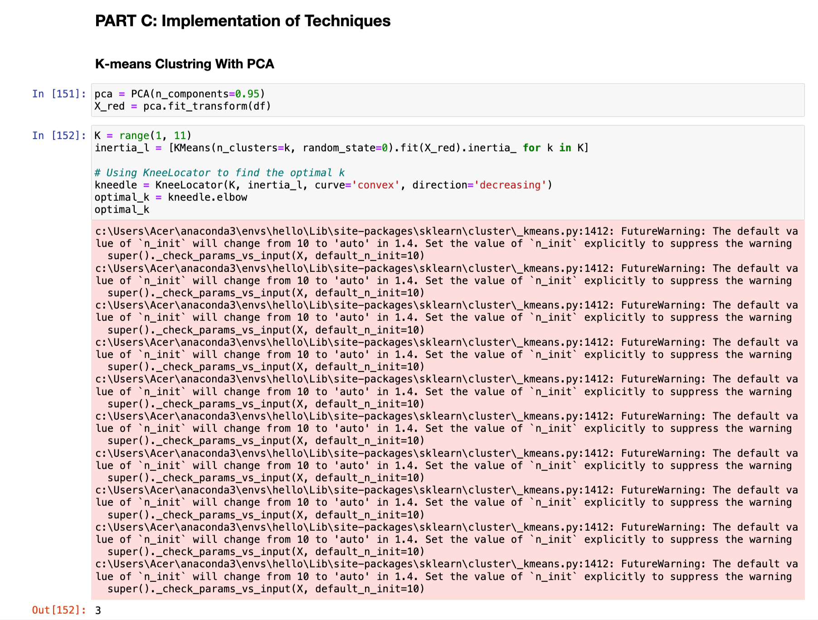
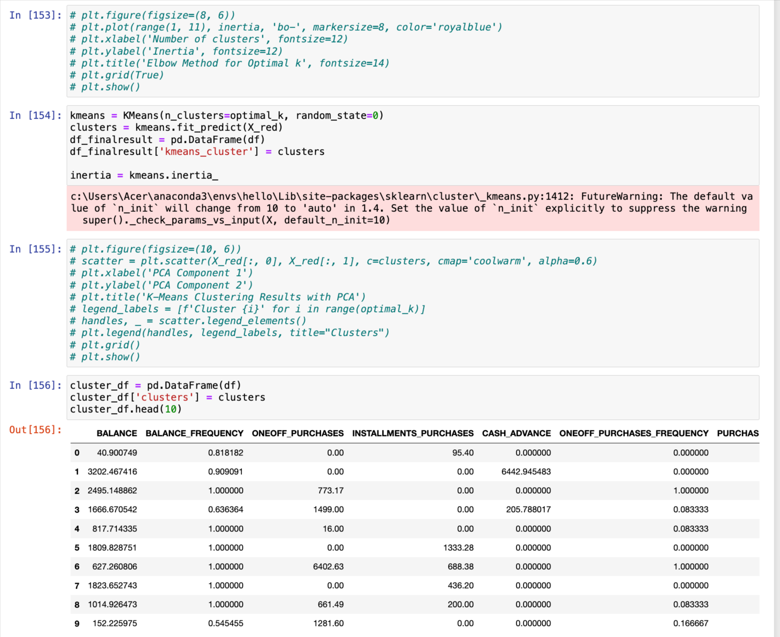
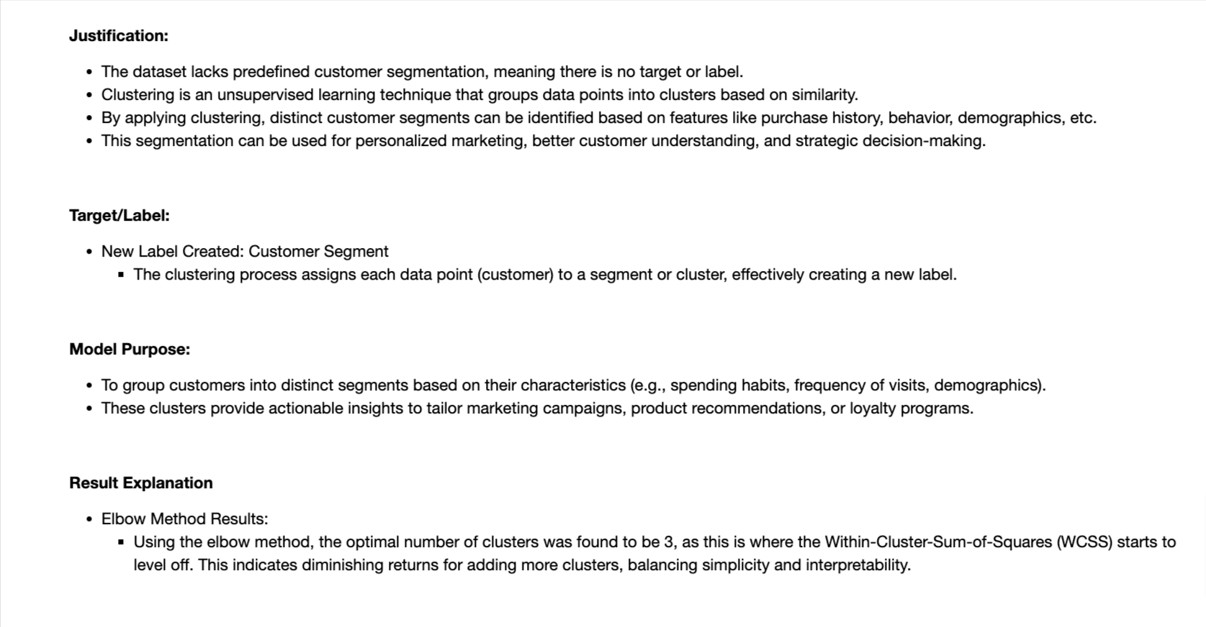

Slide 7

Technique 2; - Naïve Bayes
Steps:
Used GaussianNB model.
Split data into 80% training and 20% testing sets.
Results:
Accuracy: 88.04%
Confusion Matrix: Good performance in dominant clusters, weaker on smaller ones.
Visualization:
Confusion Matrix heatmap for prediction performance.
Completed by - Niki Patel

Slide 8
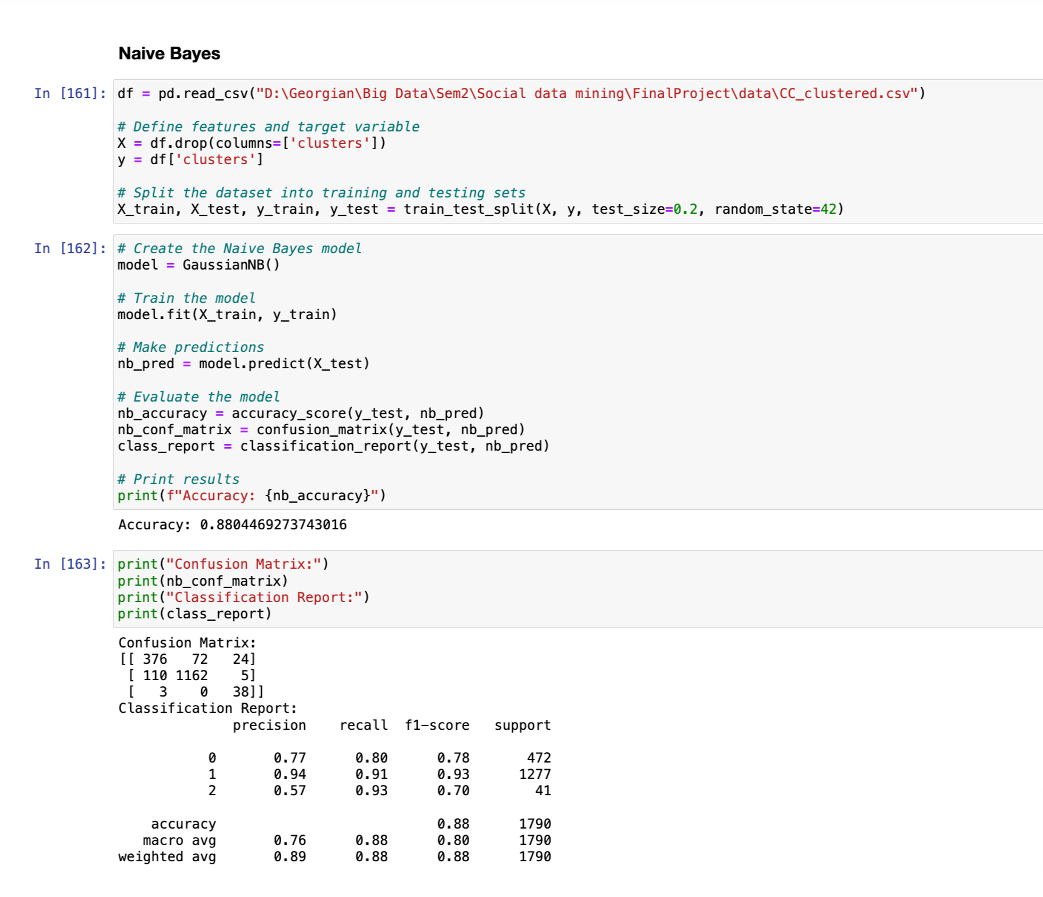

Slide 9
Reason for Choosing Naive Bayes: Naive Bayes is a probabilistic classifier that assumes conditional independence between features. It is particularly effective for tasks involving categorical or Gaussian-distributed data and works well even with a small training dataset.
In our case, the dataset contains numerical and categorical features (e.g., BALANCE, PURCHASES), and Naive Bayes can efficiently classify clusters.
The simplicity and speed of Naive Bayes make it a good choice for evaluating the clustered data and obtaining a baseline performance.
Why GaussianNB? Gaussian Naive Bayes assumes features follow a Gaussian (normal) distribution, which is suitable since the features in our dataset (like monetary values) are continuous.
The Naive Bayes model learns from the training dataset to predict the cluster (clusters) for unseen data. Specifically, it calculates probabilities of each data point belonging to each cluster using Bayes' theorem.
During prediction, it assigns the class with the highest probability as the predicted cluster for each instance.

Slide 10
Technique 2; - KNN
Steps:KNN with k=3.
Split data into training/testing (80/20).
Standardized features to improve distance calculations.
Results:Accuracy: 98.1%
Confusion Matrix: Excellent precision and recall across all clusters.
Visualization:Confusion Matrix
Bar Chart: Accuracy Comparison (Naive Bayes vs. KNN)
Completed by - Falguni Nayi

Slide 11
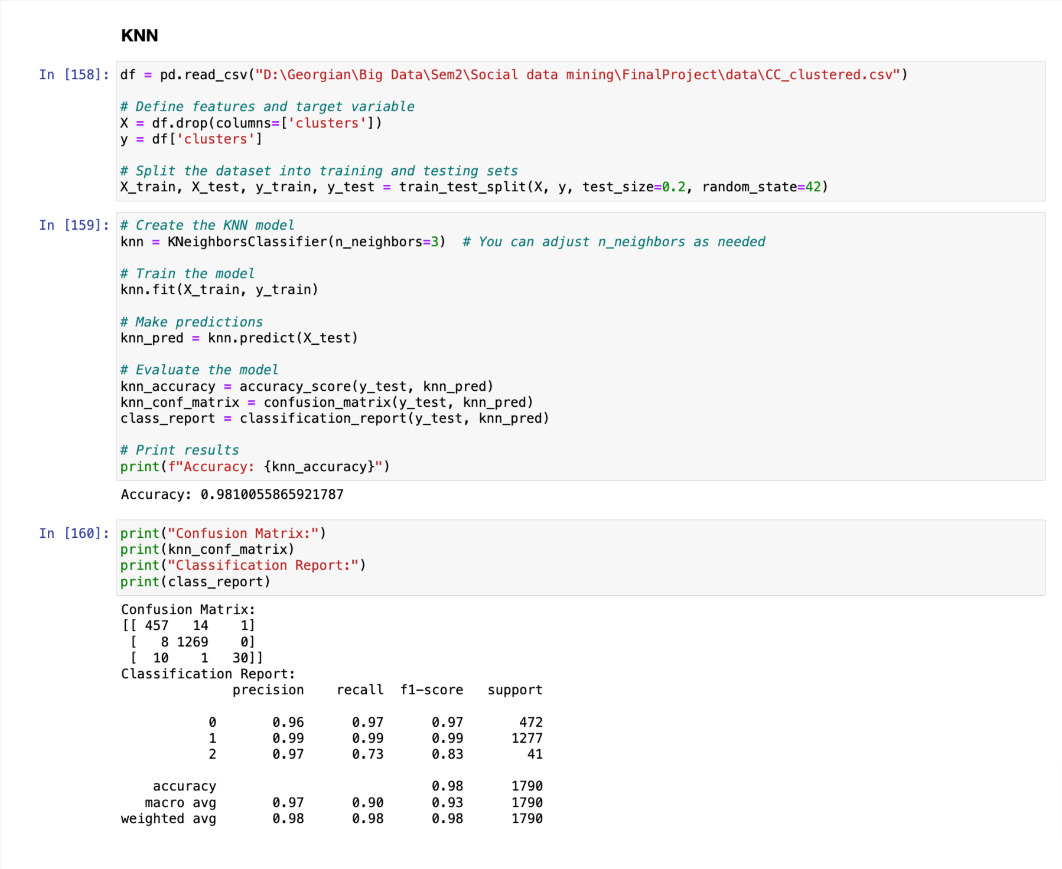

Slide 12
why KNN ? - makes no assumptions about the underlying data distribution.
KNN works well when the dataset has clear clusters, as it classifies based on the majority vote of neighbors in the feature space.
Model Purpose Objective: The purpose of the KNN model is to classify unseen data points into one of the three clusters (0, 1, or 2) based on the similarity of their features to the training samples.
How It Works: the model finds the k nearest training samples (using a distance metric, typically Euclidean distance). The majority class among the neighbors determines the predicted class.

Slide 13
Results Comparison
Dataset Characteristics
Feature Interactions:
If the dataset has significant feature interactions (e.g., features that are highly correlated), Naive Bayes struggles because it assumes independence. KNN, on the other hand, directly uses feature distances, making no independence assumption.
Class Distributions:
The dataset contains three clusters (classes), with Class 2 being a minority.
KNN does not rely on probabilistic estimates, so it can still perform well for imbalanced datasets. Naive Bayes, however, can struggle with minority classes if probabilities are skewed.
Why Did KNN Perform Better?
Better Adaptation to Feature Space: KNN adapts to the data without making assumptions about feature independence or distribution.
Robustness to Class Boundaries: KNN can handle non-linear class boundaries, while Naive Bayes assumes simpler (linear or Gaussian-based) relationships between features and classes.
Localized Decision Making: KNN makes decisions based on the closest neighbors, which gives it an advantage in datasets with well-defined clusters.
Flexibility with Imbalance: While Naive Bayes can struggle with imbalanced data, KNN, when combined with a suitable k value, performs well by leveraging the dominant class in the local neighborhood.

Slide 14

Insights and Recommendations
Insights: High spenders could be targeted with premium offers.
Low spenders might require incentives to increase engagement.
Recommendations: Combine clustering with advanced models for predictive analytics.

Slide 15

THANK YOU

